Slide 1
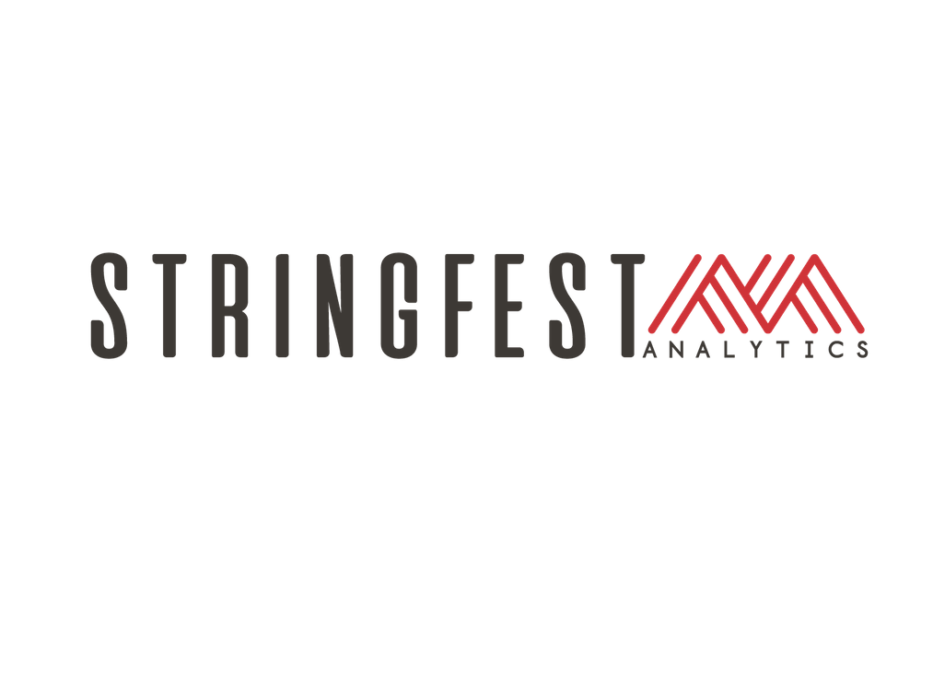
PYTHON-POWERED EXCEL
Notes:
Welcome!

Slide 2

George Mount
Data Analyst & Educator at Stringfest Analytics
George works as an independent analyst and data analytics educator with the goal to help clients manage their data so they think more creatively. He serves as a technical expert and lead curriculum developer for Thinkful’s data analytics program and is the instructor of the DataCamp course “Survey and Measure Development in R.”
George blogs about data, innovation, and career development at georgejmount.com. He holds a master’s degree in information systems with a certificate of achievement in quantitative methods from Case Western Reserve University
Notes:
Here’s me, you already learned this.

Slide 3

COURSE OBJECTIVES
Load, view and write workbooks to and from Python
Add custom formats, protections and metadata to workbooks from Python
Navigate and execute code in Jupyter notebooks
Python-Powered Excel
Notes:
All right, we have a ton of stuff to do today so I apologize now if we don’t get through it all.
Our focus is really going to be how to drive Excel from Python, you will see a couple of ways to do that. Not only will we write data to workbooks but we will use Python to do things like format cells, insert tables and manipulate other workbook properties.
If you’ve ever used VBA, you will see some comparisons, but the nice thing about Python is it integrates with so many outside functionalities for things like data analysis and data visualization. There is a lot that Python can do, but again we are going to focus on driving Excel, so for the most part I will fill out any code for you that has to dowith the data manipulation or visualization, you will focus on the code to drive Excel, and I have some great resources if you are interested in learning Python further.
We will be working in Jupyter notebooks to conduct this analysis and you will see this is a great medium for storytelling with code, as it were.

Slide 4
FOLLOWING ALONG
Each section is a sub-folder
Interactive notebooks= follow along with me
Drills = try it yourself (Solutions are in the solutions notebooks)
Python-Powered Excel
Notes:
This is a Python/Excel class, so we won’t be looking at PowerPoint the whole time – to follow along, you will see that all assets are divided by section. Most of our time will be spent walking through Jupyter notebooks together.
If you need any datasets they will be included in each sub-folder.
I also have a series of fill in the blank type drills where you will apply what you’ve learned to fill out a workbook. I will review the solution with you and you also have access to the solution files.

Slide 5
1. UP AND RUNNING WITH PYTHON IN EXCEL
Notes:
OK, let’s take a moment to situate Python and Excel with what we are achieving here. One thing I want you to take away from this is that I am NOT suggesting you abandon Excel from your daily workflow. So let’s do some comparing, contrasting and situating these tools in the context of data analysis.

Slide 6
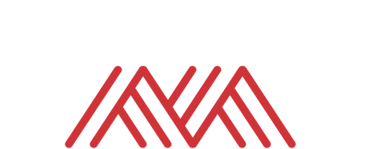
PYTHON IS:
A programming language
Open source
PYTHON IS NOT:
Commercially supported
A spreadsheet or database
Notes:
You probably know this by now but yes, Python is a coding language, and we will be coding in this class, and I really hope you take the opportunity in the drills to make this knowledge your own.
One important trait of Python which in fact our course really depends on is that Python is open-source: that is, anyone can repurpose, re-use and remix the Python code as they will. In our case, a guy named John McNamara came up with this software that anyone can load to drive Excel workbooks from Python.
That is great that there are is so much generous, free software out there, but remember that these are volunteer and not commercial products. There is no 800 number to call when things break. All that said, I would not make that limitation preclude you from using Python, but I do think it’s important to place where Python is coming from as an open-source project and what the implications for that are.
Finally, Python itself is not a spreadsheet or database in itself; we can gather and interact with data from these sources using Python but we don’t want to use Python itself to really store and distribute data. So you are already starting to see some of the differences across these tools. Let’s look at a great visualization to add further context.

Slide 7
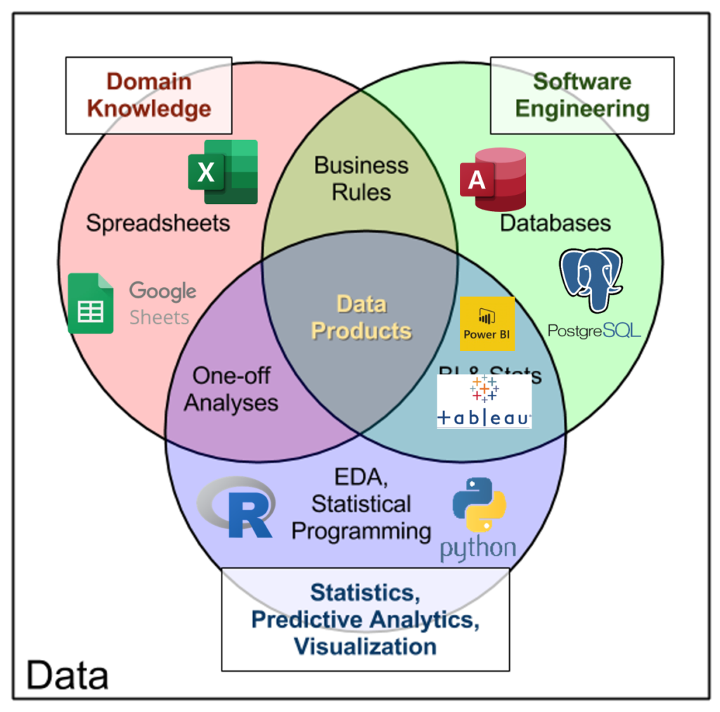
THE DATA ANALYTICS STACK
http://www.datacommunitydc.org/blog/2013/09/the-data-products-venn-diagram
Notes:
I really like this “Data Products” venn diagram that compares and contrasts the types of tools when we work with data. You see that we have spreadsheets in one ring, databases in another and statistical programming in the last one. We can use these tools in tandem to build data products. In our case, we may pull data from databases, perform analysis and then push that to our end users as Excel reports, and then finally our end users can perform quick envelope-math calculations from spreadsheets. They all connect, it’s important to see these as part of a venn diagram or a pipeline.

Slide 8

PYTHON & EXCEL: “YES, AND” DATA ANALYSIS
Notes:
So I will absolutely not be suggesting that you delete Excel from your computer. Anything but that. You are going to make Excel even more powerful by combining it with Python, and vice versa.
We want to see them as friends.

Slide 9
SEE YOU ON JUPYTER
Notes:
OK so let’s begin our Jupyter journey and learn about Python! But one last thing…

Slide 10
HOUSE RULES ON JUPYTER:
DON’T PANIC
Notes:
We will have a house rule on Jupyter which is to not panic. There will be a LOT of stuff thrown at you and some of the code may not be familiar to you at all. You may be confused at some of the code we have and I will tell you to not pay attention to it.
Again the focus of this course is to get you excited about how you can drive and automate Excel from Python. I definitely suggest you take some time to learn more Python after the course, and I have some recommended resources for you in the conclusion. But until then, let’s head to Jupyter.

Slide 11
QUESTIONS?
Notes:
Any final questions?

Slide 12
4. CONCLUSION
Notes:
All right, we are at the end of our whirlwind tour! Here is some future learning for you and some things to check out on the O’Reilly learning platform.

Slide 13

FUTURE LEARNING
The xlsxwriter covered today
pandas
seaborn
The rest of xlsxwriter
Notes:
We really just covered the tip of the iceberg

Slide 14
Future learning
Explore the xlsxwriter documentation (617 pages!)
Creating and manipulating Python data structures: lists, dictionaries
pandas for data analysis
Notes:
If you are interested in learning more, I suggest your first order of busines be to download this xlsxwriter documentation. We really scratched the surface of what’s possible with the package. There’s a lot more that is available, so if you are working on automating an Excel report, I would check the guide to see what steps are available for you.
I would also suggest spending some more time with Python itself and getting comfortable with the Pythonic way of operating with data. You’ve also seen some of pandas at the beginning and end of this course, this package will blow your mind with how it can help you analyze data.

Slide 15

Download a local Anaconda distribution of Python
Download for free at https://www.anaconda.com/products/individual
Human Centered Design • MDLS 2020
Notes:
Now, we’ve been operating on a shared O’Reilly server, but if you want to practice on your own computer, you can download Python a few ways, but I suggest downloading it from Anaconda. Remember that anyone can take the Python code and do what they want with it. This Anaconda group has bundled the code with some other awesome functionalities, and they offer a starter version to individuals for free. So then you can have it on your own computer to use Python.

Slide 16
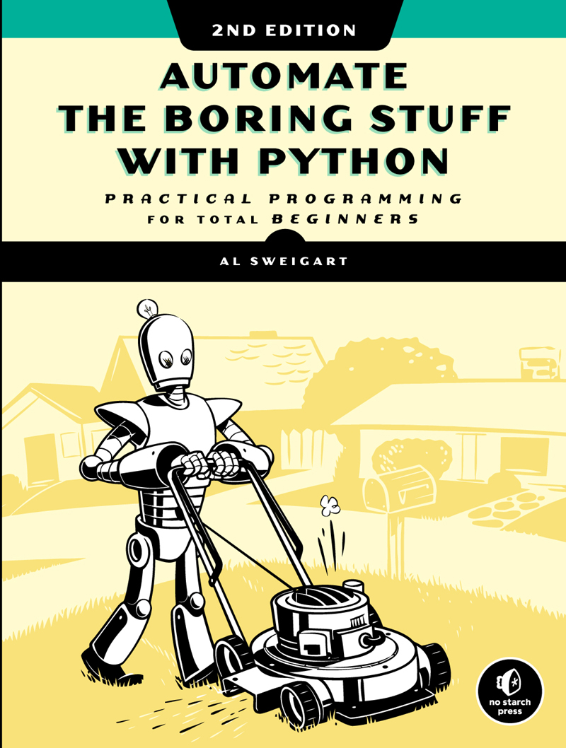
Automate the Boring Stuff with Python, 2nd Editition
by Al Sweigart
On O’Reilly Learning at https://learning.oreilly.com/library/view/automate-the-boring/9781098122584/
Human Centered Design • MDLS 2020
Notes:
I really like this book because it can show you how to automate all sorts of things in Python, including spreadsheets – and in fact, this book uses a different free package to automate Excel, so that is interesting to get a different perspective like that. But this will show you how to manipulate Google Sheets, send emails, Word Docs, etc, so maybe you would want to not just write the workbook from Python but then send it out over email, read this book and learn how.

Slide 17
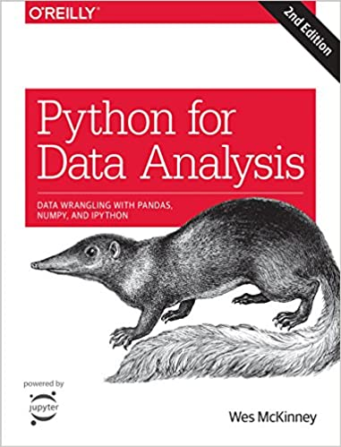
Python for Data Analysis,
2nd Edition by Wes McKinney
On O’Reilly Learning at https://learning.oreilly.com/library/view/python-for-data/9781491957653/
Human Centered Design • MDLS 2020
Notes:
This book will teach you more about using Python for data analysis, so for example maybe you want to read in some data and then run the descriptive statistics and re-calculate any columns. This book will have a lot about `pandas` which is going to be your ally for anytime you are working with spreadsheet-like data in Python.

Slide 18
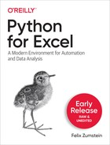
Python for Excel,
Early Release by Felix Zumstein
On O’Reilly Learning at https://learning.oreilly.com/library/view/python-for-excel/9781492080992/
Human Centered Design • MDLS 2020
Notes:
This book will teach you more about using Python for data analysis, so for example maybe you want to read in some data and then run the descriptive statistics and re-calculate any columns. This book will have a lot about `pandas` which is going to be your ally for anytime you are working with spreadsheet-like data in Python.

Slide 19
LET'S TALK
LINKEDIN
linkedin.com/in/gjmount
EMAIL ADDRESS
george@stringfestanalytics.com
WEBSITE
stringfestanalytics.com
GITHUB
github.com/summerofgeorge
Notes:
Thanks for coming! Feel free to contact me anytime, find me on LinkedIn, I also write frequently on this stuff so check out my website too.

Slide 20
QUESTIONS?
Notes:
Any final questions?

